Slide 1
Chapter-1
Introduction
Slide 1-1

Slide 2
Basic Definitions
Database: A collection of related data.
Data: Known facts that can be recorded and have an implicit meaning.
Mini-world: Some part of the real world about which data is stored in a database. For example, student grades and transcripts at a university.
Database Management System (DBMS): A software package/ system to facilitate the creation and maintenance of a computerized database.
Database System: The DBMS software together with the data itself. Sometimes, the applications are also included.
Slide 1-<number>

Slide 3
What is a File system?
A file system is a technique of arranging the files in a storage medium like a hard disk, pen drive, DVD, etc. It helps you to organizes the data and allows easy retrieval of files when they are required. It mostly consists of different types of files like mp3, mp4, txt, doc, etc. that are grouped into directories.
A file system enables you to handle the way of reading and writing data to the storage medium. It is directly installed into the computer with the Operating systems such as Windows and Linux.

Slide 4
KEY DIFFERENCES
A file system is a software that manages and organizes the files in a storage medium, whereas DBMS is a software application that is used for accessing, creating, and managing databases.
The file system doesn't have a crash recovery mechanism on the other hand, DBMS provides a crash recovery mechanism.
Data inconsistency is higher in the file system. On the contrary Data inconsistency is low in a database management system.
File system does not provide support for complicated transactions, while in the DBMS system, it is easy to implement complicated transactions using SQL.
File system does not offer concurrency, whereas DBMS provides a concurrency facility.

Slide 5
Typical DBMS Functionality
Define a database : in terms of data types, structures and constraints
Construct or Load the Database on a secondary storage medium
Manipulating the database : querying, generating reports, insertions, deletions and modifications to its content
Concurrent Processing and Sharing by a set of users and programs – yet, keeping all data valid and consistent
Slide 1-<number>

Slide 6
Typical DBMS Functionality
Other features:
  Protection or Security measures to prevent unauthorized access
  “Active” processing to take internal actions on data
  Presentation and Visualization of data
Slide 1-<number>

Slide 7
Example of a Database
(with a Conceptual Data Model)
Mini-world for the example: Part of a UNIVERSITY environment.
Some mini-world entities:
  STUDENTs
  COURSEs
  SECTIONs (of COURSEs)
  (academic) DEPARTMENTs
  INSTRUCTORs
Note: The above could be expressed in the ENTITY-RELATIONSHIP data model.
Slide 1-<number>

Slide 8
Example of a Database
(with a Conceptual Data Model)
Some mini-world relationships:
  SECTIONs are of specific COURSEs
  STUDENTs take SECTIONs
  COURSEs have prerequisite COURSEs
  INSTRUCTORs teach SECTIONs
  COURSEs are offered by DEPARTMENTs
  STUDENTs major in DEPARTMENTs
Note: The above could be expressed in the ENTITY-RELATIONSHIP data model.
Slide 1-<number>

Slide 9
Main Characteristics of the Database Approach
Self-describing nature of a database system: A DBMS catalog stores the description of the database. The description is called meta-data). This allows the DBMS software to work with different databases.
Insulation between programs and data: Called program-data independence. Allows changing data storage structures and operations without having to change the DBMS access programs.
Slide 1-<number>

Slide 10
Main Characteristics of the Database Approach
Data Abstraction: A data model is used to hide storage details and present the users with a conceptual view of the database.
Support of multiple views of the data: Each user may see a different view of the database, which describes only the data of interest to that user.
Slide 1-<number>

Slide 11
Main Characteristics of the Database Approach
Sharing of data and multiuser transaction processing : allowing a set of concurrent users to retrieve and to update the database. Concurrency control within the DBMS guarantees that each transaction is correctly executed or completely aborted. OLTP (Online Transaction Processing) is a major part of database applications.
Slide 1-<number>

Slide 12
Types of Databases and Database Applications
Numeric and Textual Databases
Multimedia Databases
Geographic Information Systems (GIS)
Data Warehouses
Real-time and Active Databases
A number of these databases and applications are described later in the book (see Chapters 24,28,29)
Slide 1-<number>

Slide 13
Database Users
Users may be divided into those who actually use and control the content (called “Actors on the Scene”) and those who enable the database to be developed and the DBMS software to be designed and implemented (called “Workers Behind the Scene”).
Slide 1-<number>

Slide 14
Database Users
Actors on the scene
  Database administrators: responsible for authorizing access to the database, for coordinating and monitoring its use, acquiring software, and hardware resources, controlling its use and monitoring efficiency of operations.
  Database Designers: responsible to define the content, the structure, the constraints, and functions or transactions against the database. They must communicate with the end-users and understand their needs.
  End-users: they use the data for queries, reports and some of them actually update the database content.
Slide 1-<number>

Slide 15
Categories of End-users
Casual : access database occasionally when needed
Naïve or Parametric : they make up a large section of the end-user population. They use previously well-defined functions in the form of “canned transactions” against the database. Examples are bank-tellers or reservation clerks who do this activity for an entire shift of operations.
Slide 1-<number>

Slide 16
Categories of End-users
Sophisticated : these include business analysts, scientists, engineers, others thoroughly familiar with the system capabilities. Many use tools in the form of software packages that work closely with the stored database.
Stand-alone : mostly maintain personal databases using ready-to-use packaged applications. An example is a tax program user that creates his or her own internal database.
Slide 1-<number>

Slide 17
Advantages of Using the Database Approach
Controlling redundancy in data storage and in development and maintenance efforts.
Sharing of data among multiple users.
Restricting unauthorized access to data.
Providing persistent storage for program Objects .
Providing Storage Structures for efficient Query Processing
Slide 1-<number>

Slide 18
Advantages of Using the Database Approach
Providing backup and recovery services.
Providing multiple interfaces to different classes of users.
Representing complex relationships among data.
Enforcing integrity constraints on the database.
Drawing Inferences and Actions using rules
Slide 1-<number>

Slide 19
Additional Implications of Using the Database Approach
Potential for enforcing standards: this is very crucial for the success of database applications in large organizations Standards refer to data item names, display formats, screens, report structures, meta-data (description of data) etc.
Reduced application development time: incremental time to add each new application is reduced.
Slide 1-<number>

Slide 20
Additional Implications of Using the Database Approach
Flexibility to change data structures: database structure may evolve as new requirements are defined.
Availability of up-to-date information – very important for on-line transaction systems such as airline, hotel, car reservations.
Economies of scale: by consolidating data and applications across departments wasteful overlap of resources and personnel can be avoided.
Slide 1-<number>

Slide 21
Extending Database Capabilities
New functionality is being added to DBMSs in the following areas:
  Scientific Applications
  Image Storage and Management
  Audio and Video data management
  Data Mining
  Spatial data management
  Time Series and Historical Data Management
Slide 1-<number>

Slide 22
When not to use a DBMS
Main inhibitors (costs) of using a DBMS:
  High initial investment and possible need for additional hardware.
  Overhead for providing generality, security, concurrency control, recovery, and integrity functions.
When a DBMS may be unnecessary:
  If the database and applications are simple, well defined, and not expected to change.
  If there are stringent real-time requirements that may not be met because of DBMS overhead.
  If access to data by multiple users is not required.
Slide 1-<number>

Slide 23
When not to use a DBMS
When no DBMS may suffice:
  If the database system is not able to handle the complexity of data because of modeling limitations
  If the database users need special operations not supported by the DBMS.
Slide 1-<number>

Slide 24
Data Models
Data Model: A set of concepts to describe the structure of a database, and certain constraints that the database should obey.
Data Model Operations: Operations for specifying database retrievals and updates by referring to the concepts of the data model. Operations on the data model may include basic operations and user-defined operations.
Slide 2-<number>

Slide 25
Database System concepts Architectures

Slide 26
Categories of data models
Conceptual (high-level, semantic) data models: Provide concepts that are close to the way many users perceive data. (Also called entity-based or object-based data models.)
Physical (low-level, internal) data models: Provide concepts that describe details of how data is stored in the computer.
Implementation (representational) data models: Provide concepts that fall between the above two, balancing user views with some computer storage details.
Slide 2-<number>

Slide 27
History of Data Models
Slide 2-<number>

Slide 28
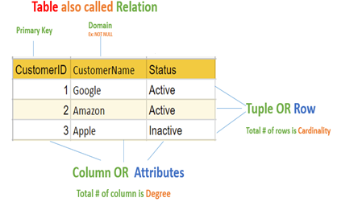
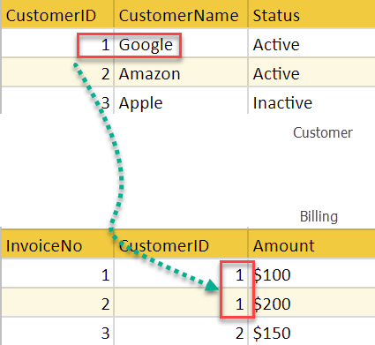
Relational Model:
proposed in 1970 by E.F. Codd (IBM), first commercial system in 1981-82. Now in several commercial products (DB2, ORACLE, SQL Server, SYBASE, INFORMIX).
The relational model represents the database as a collection of relations. A relation is nothing but a table of values. Every row in the table represents a collection of related data values. These rows in the table denote a real-world entity or relationship.

Slide 29
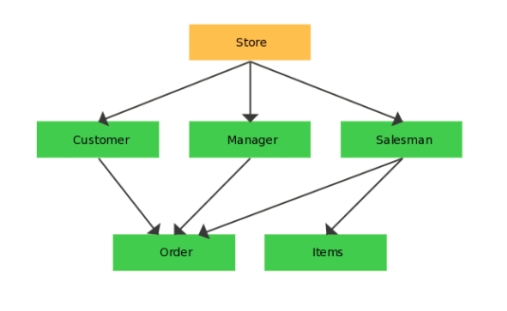
Network model
Is a database model that is designed as a flexible approach to representing objects and their relationships. A unique feature of the network model is its schema, which is viewed as a graph where relationship types are arcs and object types are nodes.
the first one to be implemented by Honeywell in 1964-65 (IDS System). Adopted heavily due to the support by CODASYL (CODASYL - DBTG report of 1971). Later implemented in a large variety of systems - IDMS (Cullinet - now CA), DMS 1100 (Unisys), IMAGE (H.P.), VAX -DBMS (Digital Equipment Corp.).

Slide 30
Network Model
ADVANTAGES:
  Network Model is able to model complex relationships and represents semantics of add/delete on the relationships.
  Can handle most situations for modeling using record types and relationship types.
  Language is navigational; uses constructs like FIND, FIND member, FIND owner, FIND NEXT within set, GET etc. Programmers can do optimal navigation through the database.
DISADVANTAGES:
  Navigational and procedural nature of processing
  Database contains a complex array of pointers that thread through a set of records. Little scope for automated "query optimization”
Slide 2-<number>

Slide 31
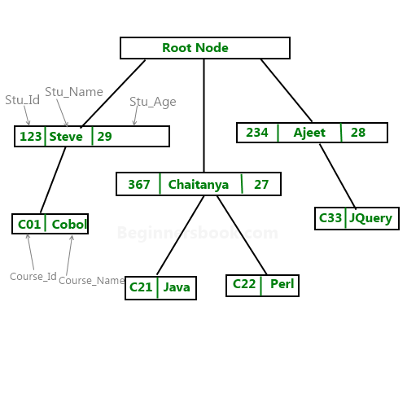
Hierarchical database model
implemented in a joint effort by IBM and North American Rockwell around 1965. Resulted in the IMS family of systems. The most popular model.
is a data model in which the data are organized into a tree-like structure. The data are stored as records which are connected to one another through links. A record is a collection of fields, with each field containing only one value. The type of a record defines which fields the record contains.
The hierarchical database model mandates that each child record has only one parent, whereas each parent record can have one or more child records. In order to retrieve data from a hierarchical database the whole tree needs to be traversed starting from the root node.

Slide 32
Hierarchical Model
ADVANTAGES:
  It promotes data sharing.
  Parent/child relationship
  Promotes conceptual simplicity.
  Database security is provided and enforced by DBMS.
  Parent/child relationship promotes data integrity.
  It is efficient with 1:M relationships.
Slide 2-<number>

Slide 33
Hierarchical Model
  DISADVANTAGES:
  Complex implementation requires knowledge of physical data storage characteristics.
  Navigational system yields complex application development, management, and use; requires knowledge of hierarchical path.
  Changes in structure require changes in all application programs.
  There are implementation limitations (no multiparent or M:N relationships).
  There is no data definition or data manipulation language in the DBMS.
  There is a lack of standards.

Slide 34
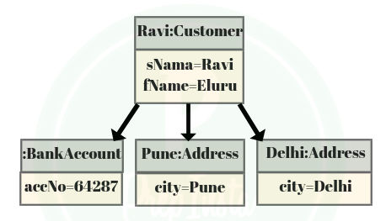
Object Oriented (OO) Data Model
Increasingly complex real-world problems demonstrated a need for a data model that more closely represented the real world. In the object oriented data model (OODM), both data and their relationships are contained in a single structure known as an object.

Slide 35
Object relational model
is a combination of a Object oriented database model and a Relational database model. So, it supports objects, classes, inheritance etc. just like Object Oriented models and has support for data types, tabular structures etc. like Relational data model.
One of the major goals of Object relational data model is to close the gap between relational databases and the object oriented practices frequently used in many programming languages such as C++, C#, Java etc.
Both Relational data models and Object oriented data models are very useful. But it was felt that they both were lacking in some characteristics and so work was started to build a model that was a combination of them both. Hence, Object relational data model was created as a result of research that was carried out in the 1990’s.
Slide 2-<number>

Slide 36
Schemas versus Instances
Database Schema: A database schema is the skeleton structure that represents the logical view of the entire database. It defines how the data is organized and how the relations among them are associated. It formulates all the constraints that are to be applied on the data.
The description of a database. Includes descriptions of the database structure and the constraints that should hold on the database.
Slide 2-<number>

Slide 37
Schema Diagram: A diagrammatic display of (some aspects of) a database schema.
Schema Construct: A component of the schema or an object within the schema, e.g., STUDENT, COURSE.
Database Instance: The actual data stored in a database at a particular moment in time. Also called database state (or occurrence).

Slide 38
Database Schema Vs. Database State
Database State: Refers to the content of a database at a moment in time.
Initial Database State: Refers to the database when it is loaded
Valid State: A state that satisfies the structure and constraints of the database.
Distinction
  The database schema changes very infrequently. The database state changes every time the database is updated.
  Schema is also called intension, whereas state is called extension.
Slide 2-<number>

Slide 39
Three-Schema Architecture
Proposed to support DBMS characteristics of:
  Program-data independence.
  Data Independence is the property of DBMS that helps you to change the Database schema at one level of a database system without requiring to change the schema at the next higher level.
  Support of multiple views of the data.
Slide 2-<number>

Slide 40


Slide 41
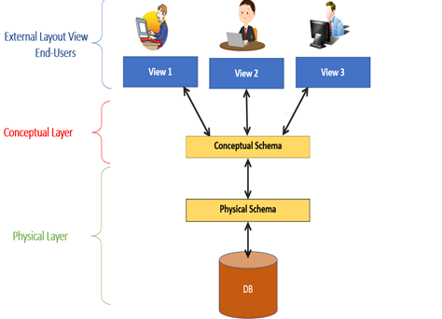
Type of Schema | Implementation
External Schema | View 1: Course info(cid:int,cname:string) View 2: studeninfo(id:int. name:string)
Conceptual Shema | Students(id: int, name: string, login: string, age: integer) Courses(id: int, cname.string, credits:integer) Enrolled(id: int, grade:string)
Physical Schema | Relations stored as unordered files. Index on the first column of Students.

Slide 42
Three-Schema Architecture
Defines DBMS schemas at three levels:
  Internal schema at the internal level to describe physical storage structures and access paths. Typically uses a physical data model.
  Conceptual schema at the conceptual level to describe the structure and constraints for the whole database for a community of users. Uses a conceptual or an implementation data model.
  External schemas at the external level to describe the various user views. Usually uses the same data model as the conceptual level.
Slide 2-<number>

Slide 43
Three-Schema Architecture
Mappings among schema levels are needed to transform requests and data. Programs refer to an external schema, and are mapped by the DBMS to the internal schema for execution.
Slide 2-<number>

Slide 44
Data Independence
Logical Data Independence: The capacity to change the conceptual schema without having to change the external schemas and their application programs.
Physical Data Independence: The capacity to change the internal schema without having to change the conceptual schema.
Slide 2-<number>

Slide 45
Due to Physical independence, any of the below change will not affect the conceptual layer.
Using a new storage device like Hard Drive or Magnetic Tapes
Modifying the file organization technique in the Database
Switching to different data structures.
Changing the access method.
Modifying indexes.
Changes to compression techniques or hashing algorithms.
Change of Location of Database from say C drive to D Drive
Due to Logical independence, any of the below change will not affect the external layer.
Add/Modify/Delete a new attribute, entity or relationship is possible without a rewrite of existing application programs
Merging two records into one
Breaking an existing record into two or more records

Slide 46
Data Independence
When a schema at a lower level is changed, only the mappings between this schema and higher-level schemas need to be changed in a DBMS that fully supports data independence. The higher-level schemas themselves are unchanged. Hence, the application programs need not be changed since they refer to the external schemas.
Slide 2-<number>

Slide 47
DBMS Languages
Data Definition Language (DDL): Used by the DBA and database designers to specify the conceptual schema of a database. In many DBMSs, the DDL is also used to define internal and external schemas (views). In some DBMSs, separate storage definition language (SDL) and view definition language (VDL) are used to define internal and external schemas.
Slide 2-<number>

Slide 48
DBMS Languages
Data Manipulation Language (DML): Used to specify database retrievals and updates.
  DML commands (data sublanguage) can be embedded in a general-purpose programming language (host language), such as COBOL, C or an Assembly Language.
  Alternatively, stand-alone DML commands can be applied directly (query language).
Slide 2-<number>

Slide 49
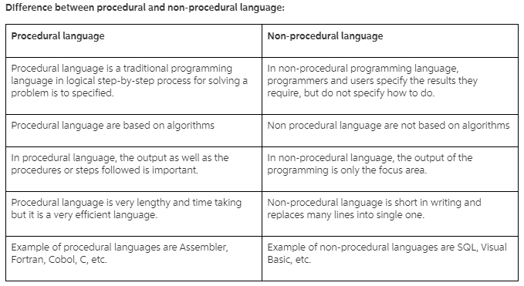
DBMS Languages
Slide 2-<number>

Slide 50
DBMS Interfaces
Stand-alone query language interfaces.
Programmer interfaces for embedding DML in programming languages:
  Pre-compiler Approach
  Procedure (Subroutine) Call Approach
User-friendly interfaces:
  Menu-based, popular for browsing on the web
  Forms-based, designed for naïve users
  Graphics-based (Point and Click, Drag and Drop etc.)
  Natural language: requests in written English
  Combinations of the above
Slide 2-<number>

Slide 51
Other DBMS Interfaces
  Speech Input and Output
  Web Browser as an interface
  Parametric interfaces (e.g., bank tellers) using function keys.
  Interfaces for the DBA:
    Creating accounts, granting authorizations
    Setting system parameters
    Changing schemas or access path
Slide 2-<number>

Slide 52
Database System Utilities
To perform certain functions such as:
  Loading data stored in files into a database. Includes data conversion tools.
  Backing up the database periodically on tape.
  Reorganizing database file structures.
  Report generation utilities.
  Performance monitoring utilities.
  Other functions, such as sorting, user monitoring, data compression, etc.
Slide 2-<number>

Slide 53
DATABASE SYSTEM ENVIORNMENT
1) DBMS Component Modules
2) Centralized and Client-Server Architectures

Slide 54

Typical DBMS Component Modules

Slide 55
Centralized and Client-Server Architectures
Centralized DBMS: combines everything into single system including- DBMS software, hardware, application programs and user interface processing software.
Slide 2-<number>

Slide 56
Basic Client-Server Architectures
Specialized Servers with Specialized functions
Clients
DBMS Server
Slide 2-<number>

Slide 57
Specialized Servers with Specialized functions:
File Servers
Printer Servers
Web Servers
E-mail Servers
Slide 2-<number>

Slide 58
Clients:
Provide appropriate interfaces and a client-version of the system to access and utilize the server resources.
Clients maybe diskless machines or PCs or Workstations with disks with only the client software installed.
Connected to the servers via some form of a network.
(LAN: local area network, wireless network, etc.)
Slide 2-<number>

Slide 59
DBMS Server
Provides database query and transaction services to the clients
Sometimes called query and transaction servers
Slide 2-<number>

Slide 60
Two Tier Client-Server Architecture
User Interface Programs and Application Programs run on the client side
Interface called ODBC (Open Database Connectivity – see Ch 9) provides an Application program interface (API) allow client side programs to call the DBMS. Most DBMS vendors provide ODBC drivers.
Slide 2-<number>

Slide 61
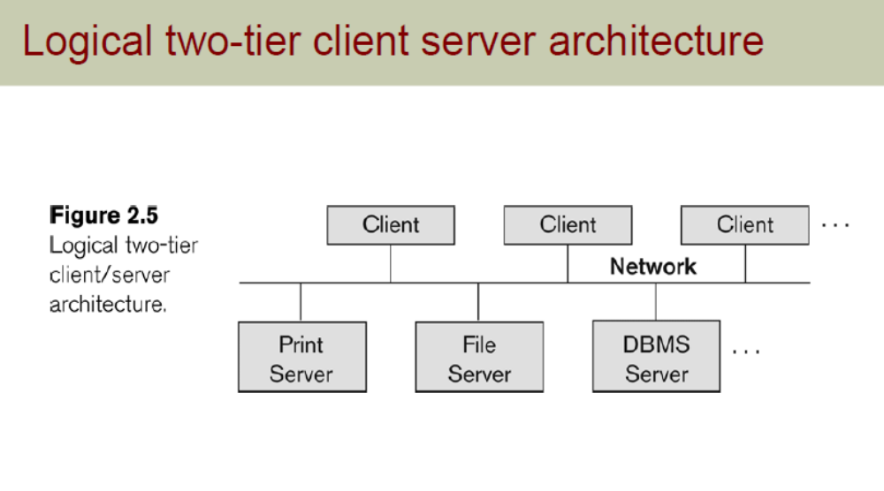

Slide 62
Two Tier Client-Server Architecture
A client program may connect to several DBMSs.
Other variations of clients are possible: e.g., in some DBMSs, more functionality is transferred to clients including data dictionary functions, optimization and recovery across multiple servers, etc. In such situations the server may be called the Data Server.
Slide 2-<number>

Slide 63
Three Tier Client-Server Architecture
Common for Web applications
Intermediate Layer called Application Server or Web Server:
  stores the web connectivity software and the rules and business logic (constraints) part of the application used to access the right amount of data from the database server
  acts like a conduit for sending partially processed data between the database server and the client.
Additional Features- Security:
  encrypt the data at the server before transmission
  decrypt data at the client
Slide 2-<number>

Slide 64
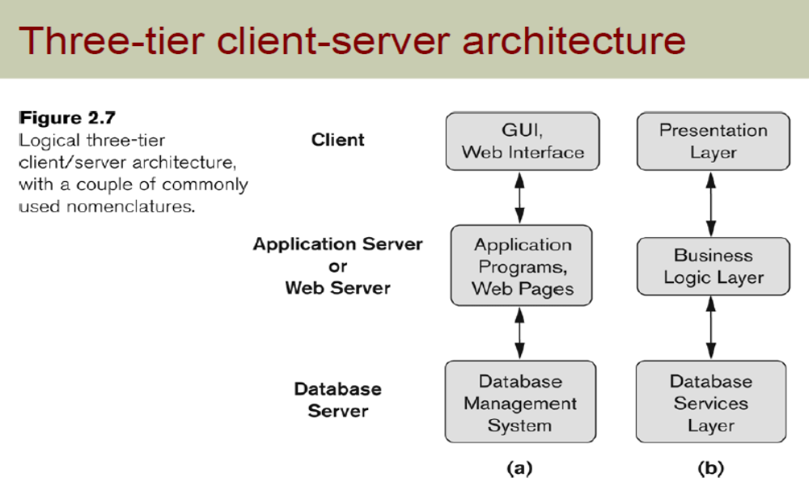

Slide 65
Classification of DBMSs
Based on the data model used:
  Traditional: Relational, Network, Hierarchical.
  Emerging: Object-oriented, Object-relational.
Other classifications:
  Single-user (typically used with micro- computers) vs. multi-user (most DBMSs).
  Centralized (uses a single computer with one database) vs. distributed (uses multiple computers, multiple databases)
Slide 2-<number>

Slide 66
Classification of DBMSs
Distributed Database Systems have now come to be known as client server based database systems because they do not support a totally distributed environment, but rather a set of database servers supporting a set of clients.
Slide 2-<number>

Slide 67
Chapter-3
Data Modelling using Entities and Relationships

Slide 68
ER Diagram
The ER or (Entity Relational Model) is a high-level conceptual data model diagram. Entity-Relation model is based on the notion of real-world entities and the relationship between them.
Helps you to define terms related to entity relationship modeling
Provide a preview of how all your tables should connect, what fields are going to be on each table
Helps to describe entities, attributes, relationships
ER diagrams are translatable into relational tables which allows you to build databases quickly
ER diagrams can be used by database designers as a blueprint for implementing data in specific software applications
The database designer gains a better understanding of the information to be contained in the database with the help of ERP diagram
ERD is allowed you to communicate with the logical structure of the database to users

Slide 69
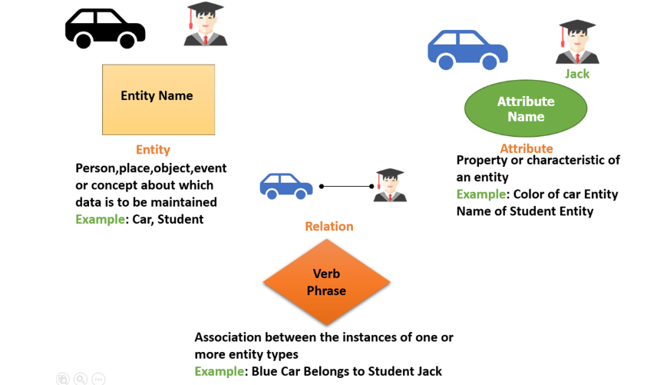
Components of the ER Diagram
This model is based on three basic concepts:
Entities Attributes Relationships

Slide 70
ER Model Concepts
Entities and Attributes
  Entities are specific objects or things in the mini-world that are represented in the database. For example the EMPLOYEE John Smith, the Research DEPARTMENT, the ProductX PROJECT
  Attributes are properties used to describe an entity. For example an EMPLOYEE entity may have a Name, SSN, Address, Sex, BirthDate
  A specific entity will have a value for each of its attributes. For example a specific employee entity may have Name='John Smith', SSN='123456789', Address ='731, Fondren, Houston, TX', Sex='M', BirthDate='09-JAN-55‘
  Each attribute has a value set (or data type) associated with it – e.g. integer, string, subrange, enumerated type, …
Chapter 3-<number>

Slide 71
Entity Types and Key Attributes
Entities with the same basic attributes are grouped or typed into an entity type. For example, the EMPLOYEE entity type or the PROJECT entity type.
An attribute of an entity type for which each entity must have a unique value is called a key attribute of the entity type. For example, SSN of EMPLOYEE.
A key attribute may be composite. For example, VehicleTagNumber is a key of the CAR entity type with components (Number, State).
An entity type may have more than one key. For example, the CAR entity type may have two keys:
  VehicleIdentificationNumber (popularly called VIN) and
  VehicleTagNumber (Number, State), also known as license_plate number.
Chapter 3-<number>

Slide 72
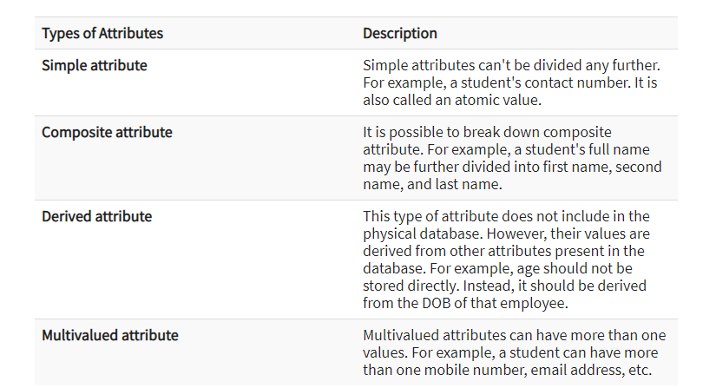
Types of Attributes

Slide 73
Types of Attributes Examples
Simple
  Each entity has a single atomic value for the attribute. For example, SSN or Sex.
Composite
  The attribute may be composed of several components. For example, Address (Apt#, House#, Street, City, State, ZipCode, Country) or Name (FirstName, MiddleName, LastName). Composition may form a hierarchy where some components are themselves composite.
Multi-valued
  An entity may have multiple values for that attribute. For example, Color of a CAR or PreviousDegrees of a STUDENT. Denoted as {Color} or {PreviousDegrees}.
Chapter 3-<number>

Slide 74
Types of Attributes (2)
In general, composite and multi-valued attributes may be nested arbitrarily to any number of levels although this is rare. For example, PreviousDegrees of a STUDENT is a composite multi-valued attribute denoted by {PreviousDegrees (College, Year, Degree, Field)}.
Chapter 3-<number>

Slide 75
ENTITY SET corresponding to the
ENTITY TYPE CAR
CAR
Registration(RegistrationNumber, State), VehicleID, Make, Model, Year, (Color)
car₁
((ABC 123, TEXAS), TK629, Ford Mustang, convertible, 1999, (red, black))
car₂
((ABC 123, NEW YORK), WP9872, Nissan 300ZX, 2-door, 2002, (blue))
car₃
((VSY 720, TEXAS), TD729, Buick LeSabre, 4-door, 2003, (white, blue))
.
.
.
Chapter 3-<number>

Slide 76
What are Keys in DBMS?
KEYS in DBMS is an attribute or set of attributes which helps you to identify a row(tuple) in a relation(table). They allow you to find the relation between two tables. Keys help you uniquely identify a row in a table by a combination of one or more columns in that table. Key is also helpful for finding unique record or row from the table. Database key is also helpful for finding unique record or row from the table.

Slide 77
Types of Keys
Super Key - A super key is a group of single or multiple keys which identifies rows in a table.
Primary Key - is a column or group of columns in a table that uniquely identify every row in that table.
Candidate Key - is a set of attributes that uniquely identify tuples in a table. Candidate Key is a super key with no repeated attributes.
Alternate Key - is a column or group of columns in a table that uniquely identify every row in that table.

Slide 78
Types of Keys
Foreign Key - is a column that creates a relationship between two tables. The purpose of Foreign keys is to maintain data integrity and allow navigation between two different instances of an entity.
Compound Key - has two or more attributes that allow you to uniquely recognize a specific record. It is possible that each column may not be unique by itself within the database.
Composite Key - An artificial key which aims to uniquely identify each record is called a surrogate key. These kind of key are unique because they are created when you don't have any natural primary key.

Slide 79

SUMMARY OF ER-DIAGRAM
NOTATION FOR ER SCHEMAS
Chapter 3-<number>

Slide 80

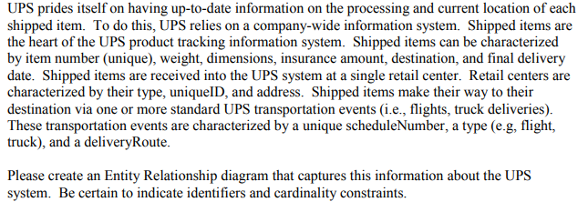

Slide 81
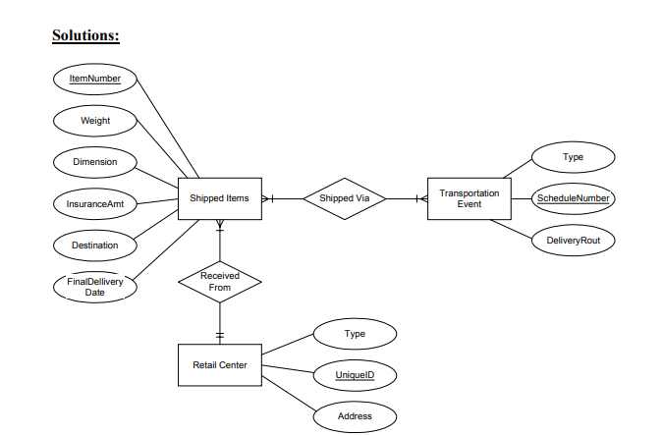

Slide 82
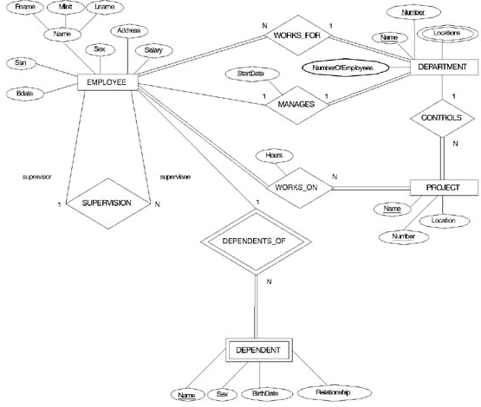
ER DIAGRAM – Entity Types are:
EMPLOYEE, DEPARTMENT, PROJECT, DEPENDENT
Chapter 3-<number>

Slide 83
Relationships and Relationship Types (1)
A relationship relates two or more distinct entities with a specific meaning. For example, EMPLOYEE John Smith works on the ProductX PROJECT or EMPLOYEE Franklin Wong manages the Research DEPARTMENT.
Relationships of the same type are grouped or typed into a relationship type. For example, the WORKS_ON relationship type in which EMPLOYEEs and PROJECTs participate, or the MANAGES relationship type in which EMPLOYEEs and DEPARTMENTs participate.
The degree of a relationship type is the number of participating entity types. Both MANAGES and WORKS_ON are binary relationships.
Chapter 3-<number>

Slide 84
Example relationship instances of the WORKS_FOR relationship between EMPLOYEE and DEPARTMENT
EMPLOYEE
WORKS_FOR
DEPARTMENT
e_{1 }
e_{2 }
e_{3 }
e_{4 }
e_{5 }
e_{6 }
e_{7 }
r₁
r₂
r₃
r₄
r₅
r₆
r₇
● d₁
● d₂
● d₃
Chapter 3-<number>

Slide 85
Example relationship instances of the WORKS_ON relationship between EMPLOYEE and PROJECT
e_{1 }
e_{2 }
e_{3 }
e_{4 }
e_{5 }
e_{6 }
e_{7 }
r₉
r₁
r₂
r₃
r₄
r₅
r₆
r₇
● p₁
● p₂
● p₃
r₈
Chapter 3-<number>

Slide 86
Example
We store each employee’s name (first, last, MI), Social Security number (SSN), street address, salary, sex, and birth date. An employee is assigned to one department, but may work on several projects, which are not necessarily controlled by the same department. We keep track of the current number of hours per week that an employee works on each project. We also keep track of the direct supervisor of each employee (who is another employee).

Slide 87
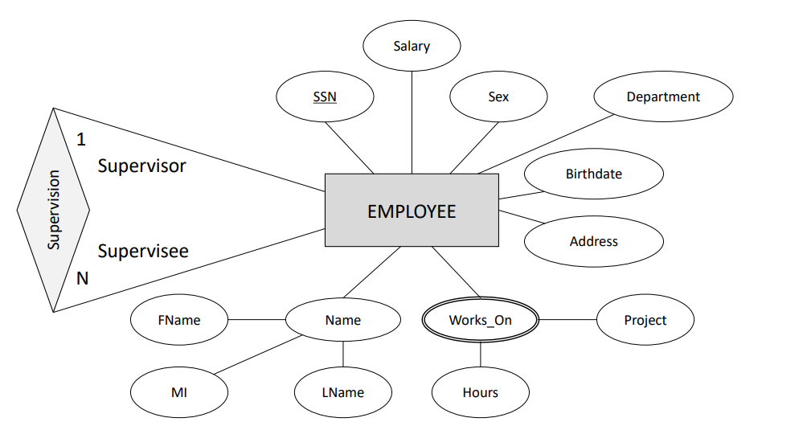

Slide 88
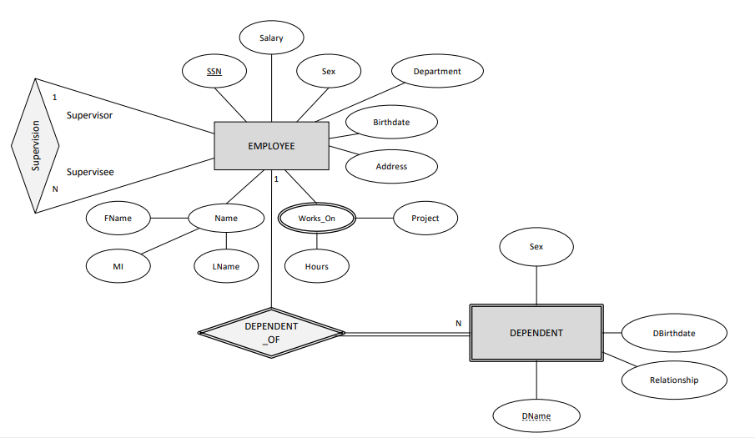

Slide 89
Relationships and Relationship Types (2)
More than one relationship type can exist with the same participating entity types. For example, MANAGES and WORKS_FOR are distinct relationships between EMPLOYEE and DEPARTMENT, but with different meanings and different relationship instances.
Chapter 3-<number>

Slide 90
ER DIAGRAM – Relationship Types are:
WORKS_FOR, MANAGES, WORKS_ON, CONTROLS,
SUPERVISION, DEPENDENTS_OF
Chapter 3-<number>

Slide 91
Weak Entity Types
An entity that does not have a key attribute
A weak entity must participate in an identifying relationship type with an owner or identifying entity type
Entities are identified by the combination of:
  A partial key of the weak entity type
  The particular entity they are related to in the identifying entity type
Example:
Suppose that a DEPENDENT entity is identified by the dependent’s first name and birhtdate, and the specific EMPLOYEE that the dependent is related to. DEPENDENT is a weak entity type with EMPLOYEE as its identifying entity type via the identifying relationship type DEPENDENT_OF
Chapter 3-<number>

Slide 92
Weak Entity Type is: DEPENDENT
Identifying Relationship is: DEPENDENTS_OF
Chapter 3-<number>

Slide 93
Constraints on Relationships
Constraints on Relationship Types
  ( Also known as ratio constraints )
  Maximum Cardinality
    One-to-one (1:1)
    One-to-many (1:N) or Many-to-one (N:1)
    Many-to-many
  Minimum Cardinality (also called participation constraint or existence dependency constraints)
    zero (optional participation, not existence-dependent)
    one or more (mandatory, existence-dependent)
Chapter 3-<number>

Slide 94

Many-to-one (N:1) RELATIONSHIP
Chapter 3-<number>

Slide 95

Many-to-many (M:N) RELATIONSHIP
Chapter 3-<number>

Slide 96
Relationships and Relationship Types (3)
We can also have a recursive relationship type.
Both participations are same entity type in different roles.
For example, SUPERVISION relationships between EMPLOYEE (in role of supervisor or boss) and (another) EMPLOYEE (in role of subordinate or worker).
In following figure, first role participation labeled with 1 and second role participation labeled with 2.
In ER diagram, need to display role names to distinguish participations.
Chapter 3-<number>

Slide 97

A RECURSIVE RELATIONSHIP SUPERVISION
© The Benjamin/Cummings Publishing Company, Inc. 1994, Elmasri/Navathe, Fundamentals of Database Systems, Second Edition
Chapter 3-<number>

Slide 98
Recursive Relationship Type is: SUPERVISION
(participation role names are shown)
Chapter 3-<number>

Slide 99
Attributes of Relationship types
A relationship type can have attributes; for example, HoursPerWeek of WORKS_ON; its value for each relationship instance describes the number of hours per week that an EMPLOYEE works on a PROJECT.
Chapter 3-<number>

Slide 100
Attribute of a Relationship Type is:
Hours of WORKS_ON
Chapter 3-<number>

Slide 101
Structural Constraints – one way to express semantics of relationships
Structural constraints on relationships:
Cardinality ratio (of a binary relationship): 1:1, 1:N, N:1, or M:N
  SHOWN BY PLACING APPROPRIATE NUMBER ON THE LINK.
Participation constraint (on each participating entity type): total (called existence dependency) or partial.
SHOWN BY DOUBLE LINING THE LINK
NOTE: These are easy to specify for Binary Relationship Types.
Chapter 3-<number>

Slide 102
Alternative (min, max) notation for relationship structural constraints:
Specified on each participation of an entity type E in a relationship type R
Specifies that each entity e in E participates in at least min and at most max relationship instances in R
Default(no constraint): min=0, max=n
Must have min≤max, min≥0, max ≥1
Derived from the knowledge of mini-world constraints
Examples:
A department has exactly one manager and an employee can manage at most one department.
  Specify (0,1) for participation of EMPLOYEE in MANAGES
  Specify (1,1) for participation of DEPARTMENT in MANAGES
An employee can work for exactly one department but a department can have any number of employees.
  Specify (1,1) for participation of EMPLOYEE in WORKS_FOR
  Specify (0,n) for participation of DEPARTMENT in WORKS_FOR
Chapter 3-<number>

Slide 103
The (min,max) notation relationship constraints
(0,1)
(1,1)
Employee
Manages
Department
(1,1)
(1,N)
Employee
Department
Works-for
Chapter 3-<number>

Slide 104
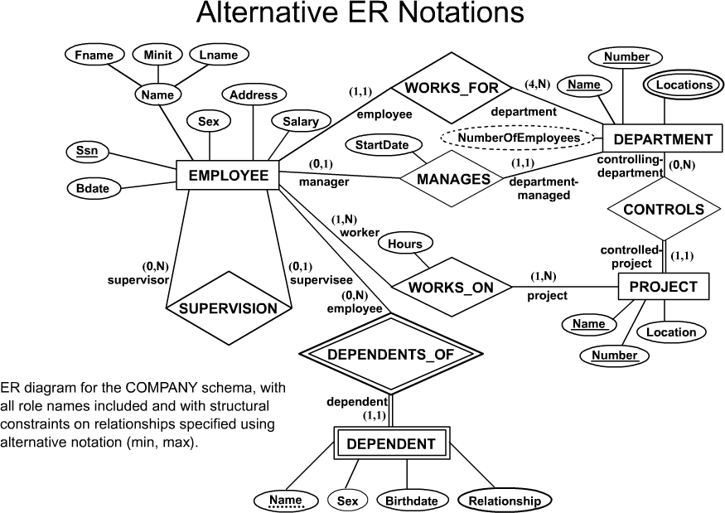
COMPANY ER Schema Diagram using (min, max) notation
Chapter 3-<number>

Slide 105
Relationships of Higher Degree
Relationship types of degree 2 are called binary
Relationship types of degree 3 are called ternary and of degree n are called n-ary
In general, an n-ary relationship is not equivalent to n binary relationships
Higher-order relationships discussed further in Chapter 4
Chapter 3-<number>

Slide 106
Data Modeling Tools
A number of popular tools that cover conceptual modeling and mapping into relational schema design. Examples: ERWin, S- Designer (Enterprise Application Suite), ER- Studio, etc.
POSITIVES: serves as documentation of application requirements, easy user interface - mostly graphics editor support
Chapter 3-<number>

Slide 107
Problems with Current Modeling Tools
DIAGRAMMING
  Poor conceptual meaningful notation.
  To avoid the problem of layout algorithms and aesthetics of diagrams, they prefer boxes and lines and do nothing more than represent (primary-foreign key) relationships among resulting tables.(a few exceptions)
METHODOLGY
  lack of built-in methodology support.
  poor tradeoff analysis or user-driven design preferences.
  poor design verification and suggestions for improvement.
Chapter 3-<number>

Slide 108
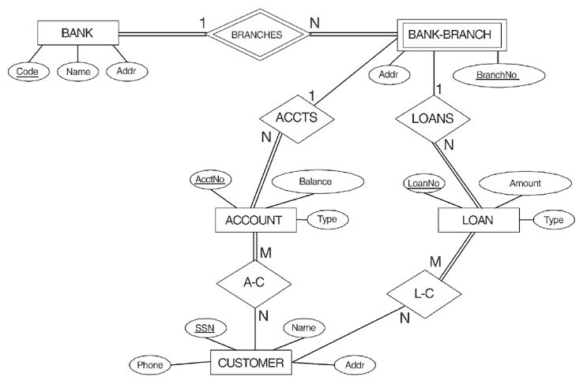
ER DIAGRAM FOR A BANK
DATABASE
© The Benjamin/Cummings Publishing Company, Inc. 1994, Elmasri/Navathe, Fundamentals of Database Systems, Second Edition
Chapter 3-<number>

Slide 109
PROBLEM with ER notation
THE ENTITY RELATIONSHIP MODEL IN ITS ORIGINAL FORM DID NOT SUPPORT THE SPECIALIZATION/ GENERALIZATION ABSTRACTIONS
Chapter 3-<number>

Slide 110
Extended Entity-Relationship (EER) Model
Incorporates Set-subset relationships
Incorporates Specialization/Generalization Hierarchies
NEXT CHAPTER ILLUSTRATES HOW THE ER MODEL CAN BE EXTENDED WITH
- Set-subset relationships and Specialization/Generalization Hierarchies and how to display them in EER diagrams
Chapter 3-<number>

Slide 111
Thank YOU

